Slide 1
332:479 Concepts in VLSI
Design
Lecture 21
Built-In Self-Testing
Built-in Self-testing definitions
Economics
Linear feedback shift register
Multiple-Input Shift Register
Built-In Logic Block Observer (BILBO)
Test Point insertion
Summary

Slide 2
Source:Essentials of Electronic Testing for Logic, Memory, and Mixed-Signal Circuits, by M. L. Bushnell and V. D. Agrawal, Kluwer Academic Press, 2000

Slide 3
Economics – BIST Costs
  Chip area overhead for:
    Test controller
    Hardware pattern generator
    Hardware response compacter
    Testing of BIST hardware
  Pin overhead -- At least 1 pin needed to activate BIST operation
  Performance overhead – extra path delays due to BIST
  Yield loss – due to increased chip area or more chips In system because of BIST
  Reliability reduction – due to increased area
  Increased BIST hardware complexity – happens when BIST hardware is made testable

Slide 4
BIST Benefits
Faults tested:
  Single combinational / sequential stuck-at faults
  Delay faults
  Single stuck-at faults in BIST hardware
BIST benefits
  Reduced testing and maintenance cost
  Lower test generation cost
  Reduced storage / maintenance of test patterns
  Simpler and less expensive ATE
  Can test many units in parallel
  Shorter test application times
  Can test at functional system speed

Slide 5
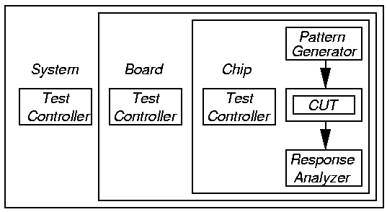
BIST Process
Test controller – Hardware that activates self-test simultaneously on all PCBs
Each board controller activates parallel chip BIST Diagnosis effective only if very high fault coverage

Slide 6
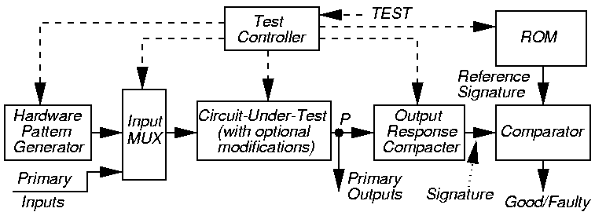
BIST Architecture
Note: BIST cannot test wires and transistors:
  From PI pins to Input MUX
  From POs to output pins

Slide 7
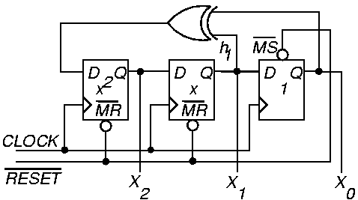
External XOR Linear Feedback Shift Register (LFSR)
Characteristic polynomial f (x) = 1 + x + x³
  (read taps from right to left)

Slide 8
External XOR LFSR
Pattern sequence for example LFSR (earlier):
Always have 1 and x^{n} terms in polynomial
Never repeat an LFSR pattern more than 1 time –Repeats same error vector, cancels fault effect
X₀
X₁
X₂
1
0
0
0
0
1
0
1
0
1
0
1
0
1
1
1
1
1
1
1
0
1
0
0
0
0
1
…

Slide 9
Response Compaction
Severe amounts of data in CUT response to LFSR patterns – example:
  Generate 5 million random patterns
  CUT has 200 outputs
  Leads to: 5 million x 200 = 1 billion bits response
Uneconomical to store and check all of these responses on chip
Responses must be compacted

Slide 10
Definitions
Aliasing – Due to information loss, signatures of good and some bad machines match
Compaction – Drastically reduce # bits in original circuit response – lose information
Compression – Reduce # bits in original circuit response – no information loss – fully invertible (can get back original response)
Signature analysis – Compact good machine response into good machine signature. Actual signature generated during testing, and compared with good machine signature

Slide 11
LFSR for Response Compaction
Use cyclic redundancy check code (CRCC) generator (LFSR) for response compacter
Treat data bits from circuit POs to be compacted as a decreasing order coefficient polynomial
CRCC divides the PO polynomial by its characteristic polynomial
  Leaves remainder of division in LFSR
  Must initialize LFSR to seed value (usually 0) before testing
After testing – compare signature in LFSR to known good machine signature
Critical: Must compute good machine signature

Slide 12
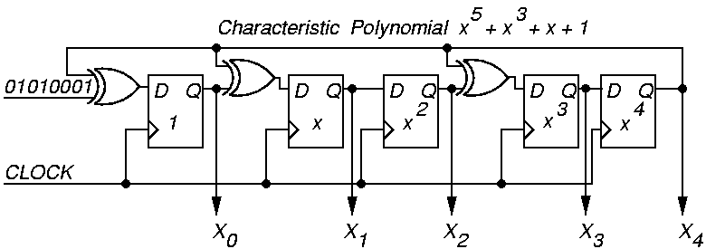
Example Modular LFSR Response Compacter
LFSR seed value is “00000”

Slide 13
Polynomial Division
Inputs
Initial State
1
0
0
0
1
0
1
0
X⁰
0
1
0
0
0
1
1
1
1
X¹
0
0
1
0
0
0
0
1
0
X²
0
0
0
1
0
0
0
0
1
X³
0
0
0
0
1
0
1
0
1
X⁴
0
0
0
0
0
1
0
1
0
Logic
Simulation:
Logic simulation: Remainder = 1 + x² + x³
0 1 0 1 0 0 0 1
0 x⁰ + 1 x¹ + 0 x² + 1 x³ + 0 x⁴ + 0 x⁵ + 0 x⁶ + 1 x⁷
.
.
.
.
.
.
.
.

Slide 14
Symbolic Polynomial Division
x²
x⁷
x⁷
+ 1
+ x⁵
x⁵
x⁵
+ x³
+ x³
+ x³
x³
+ x
+ x
+ x
x⁵ + x³ + x + 1
+ x²
+ x²
+ x²
+ 1
+ 1
remainder
Remainder matches that from logic simulation
of the response compacter!

Slide 15
Multiple-Input Signature Register (MISR)
Problem with ordinary LFSR response compacter:
  Too much hardware if one of these is put on each primary output (PO)
Solution: MISR – compacts all outputs into one LFSR
  Works because LFSR is linear – obeys superposition principle
  Superimpose all responses in one LFSR – final remainder is XOR sum of remainders of polynomial divisions of each PO by the characteristic polynomial

Slide 16
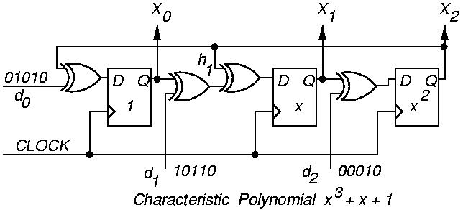
Modular MISR Example

Slide 17
Aliasing Theorems
Theorem 15.2: Assuming that each PO d_{ij} has probability p_{j} of being in error, where the p_{j} probabilities are independent, and that all outputs d_{ij} are independent, in a k-bit MISR, P_{al} = 1/(2^{k}), regardless of the initial condition.

Slide 18
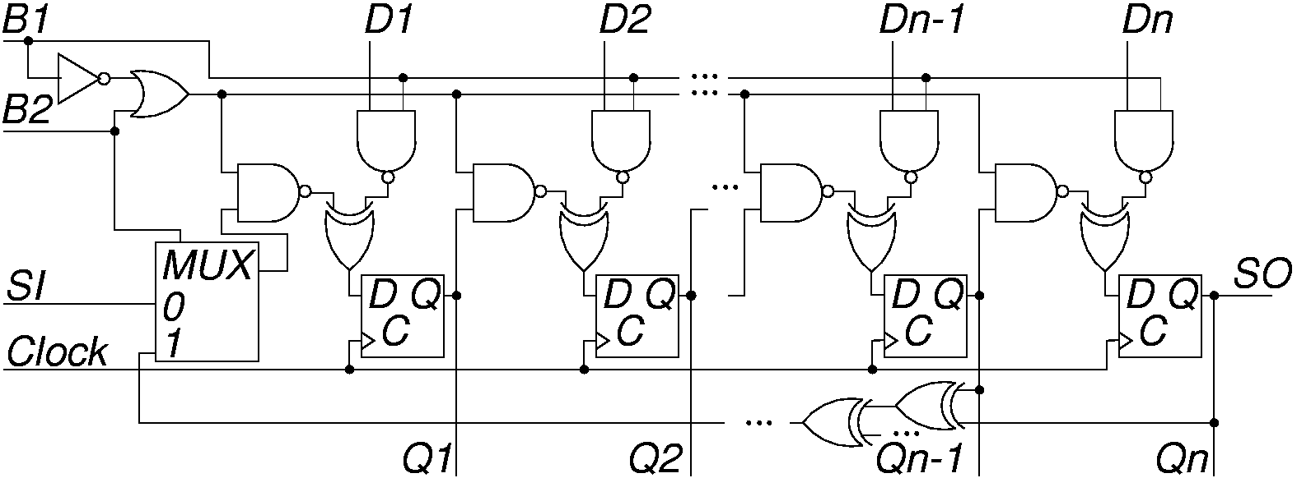
Built-in Logic Block Observer (BILBO)
Combined functionality of D flip-flop, pattern generator, response compacter, & scan chain
  Reset all FFs to 0 by scanning in zeros

Slide 19
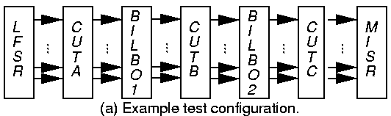
Example BILBO Usage
SI – Scan In
SO – Scan Out
Characteristic polynomial: 1 + x + … + x^{n}
CUTs A and C: BILBO1 is MISR, BILBO2 is LFSR
CUT B: BILBO1 is LFSR, BILBO2 is MISR

Slide 20
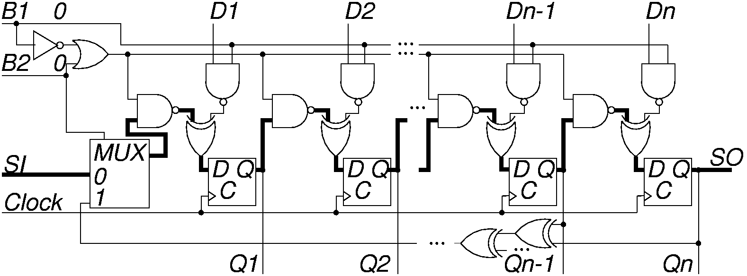
BILBO Serial Scan Mode
B1 B2 = “00”
Dark lines show enabled data paths

Slide 21
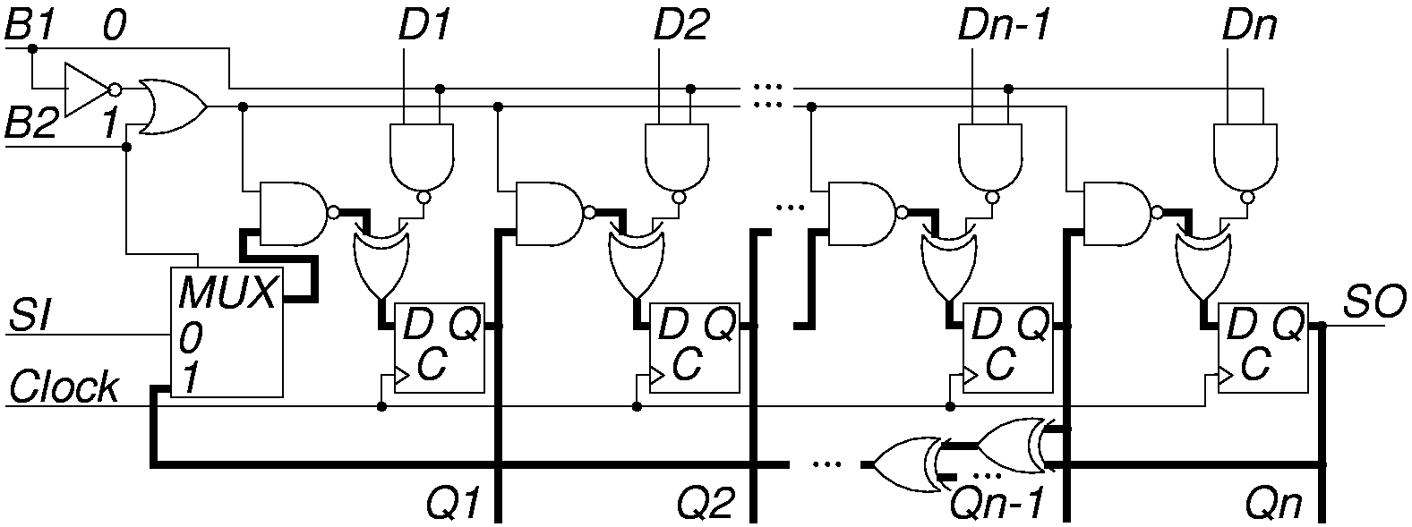
BILBO LFSR Pattern Generator Mode
B1 B2 = “01”

Slide 22
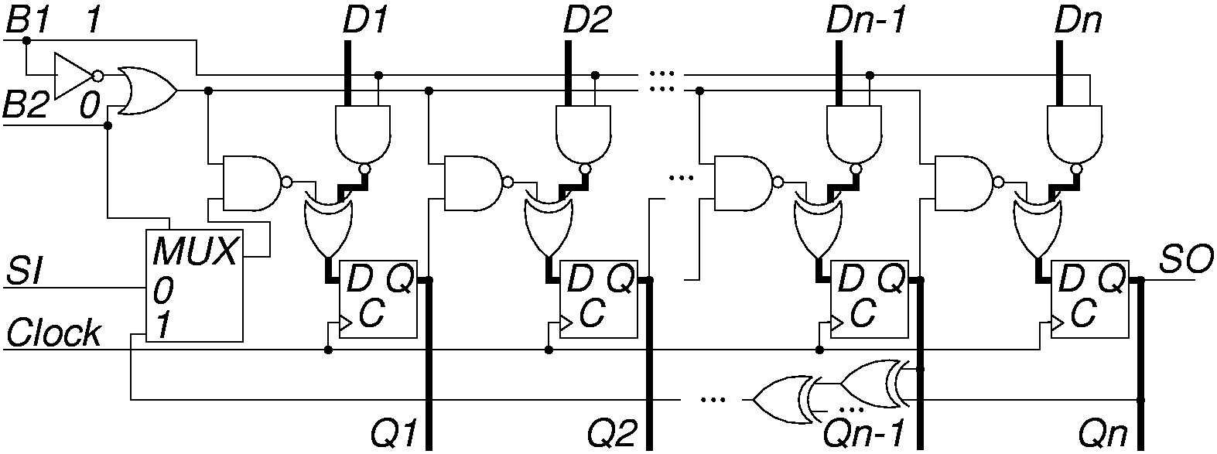
BILBO in D FF (Normal) Mode
B1 B2 = “10”

Slide 23
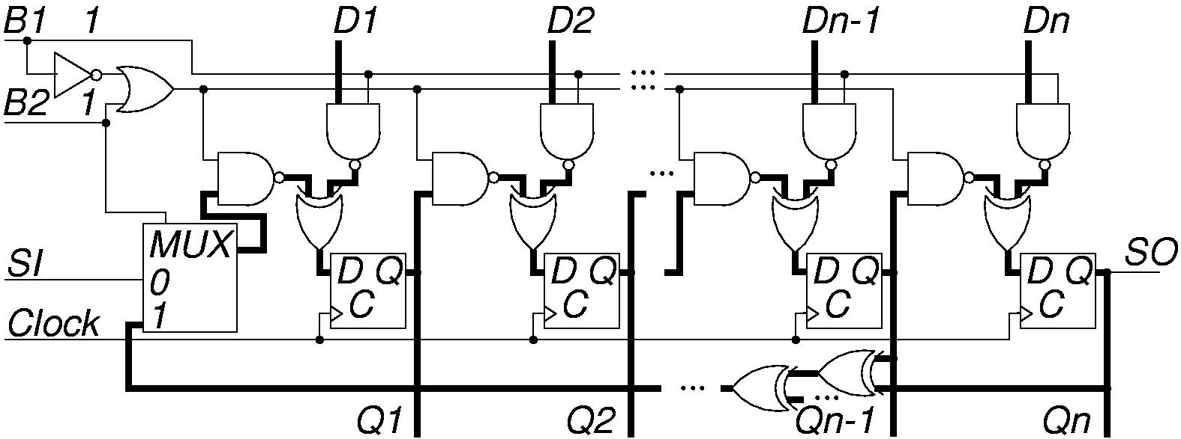
BILBO in MISR Mode
B1 B2 = “11”

Slide 24
Circuit Initialization
Full-scan BIST – shift in scan chain seed before starting BIST
Partial-scan BIST – critical to initialize all FFs before BIST starts
  Otherwise we clock X’s into MISR and signature is not unique and not repeatable
Discover initialization problems by:
  Modeling all BIST hardware
  Setting all FFs to X’s
  Running logic simulation of CUT with BIST hardware

Slide 25
Circuit Initialization (continued)
If MISR finishes with BIST cycle with X’s in signature, Design-for-Testability initialization hardware must be added
Add MS (master set) or MR (master reset) lines on flip-flops and excite them before BIST starts
Otherwise:
  Break all cycles of FF’s
  Apply a partial BIST synchronizing sequence to initialize all FF’s
  Turn on the MISR to compact the response

Slide 26
Test Point Insertion
BIST does not detect all faults:
  Test patterns not rich enough to test all faults
Modify circuit after synthesis to improve signal controllability
Observability addition – Route internal signal to extra FF in MISR or XOR into existing FF in MISR

Slide 27
Summary
LFSR pattern generator and MISR response compacter – preferred BIST methods
BIST has overheads: test controller, extra delay, Input MUX, pattern generator, response compacter, DFT to initialize circuit & test the test hardware
BIST benefits:
  At-speed testing for delay & stuck-at faults
  Drastic ATE cost reduction
  Field test capability
  Faster diagnosis during system test
  Less effort to design testing process
  Shorter test application times

